Slide 1


Session #INN104
UX Process—
What Can We Learn and Leverage?
Jean Marrapodi, PhD, CPLP
Illumina Interactive
Las Vegas, NV • November 16 – 18, 2016

Slide 2
An eLearning Course must meet the demands of many factions
eLearning course
Business Owner
Content
Project Manager
Instructional Designer
Graphic Designer
IT
LMS
Sponsor

Slide 3

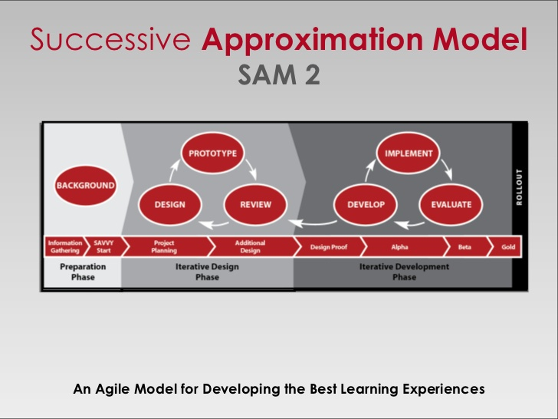
Development typically follows ADDIE or SAM

Slide 4
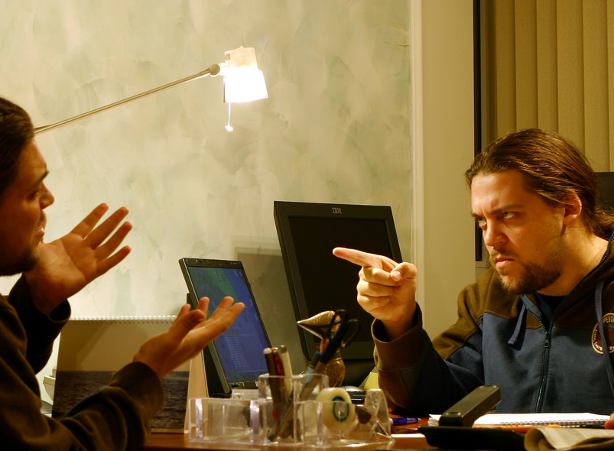
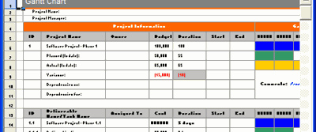

We wrangle with competing priorities, schedules and politics.

Slide 5

Who is looking out for the user?

Slide 6
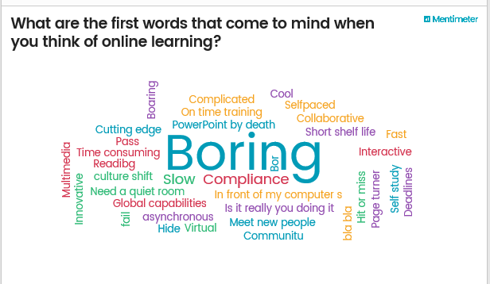
Results from ATD New England Conference, April 2016

Slide 7


Slide 8
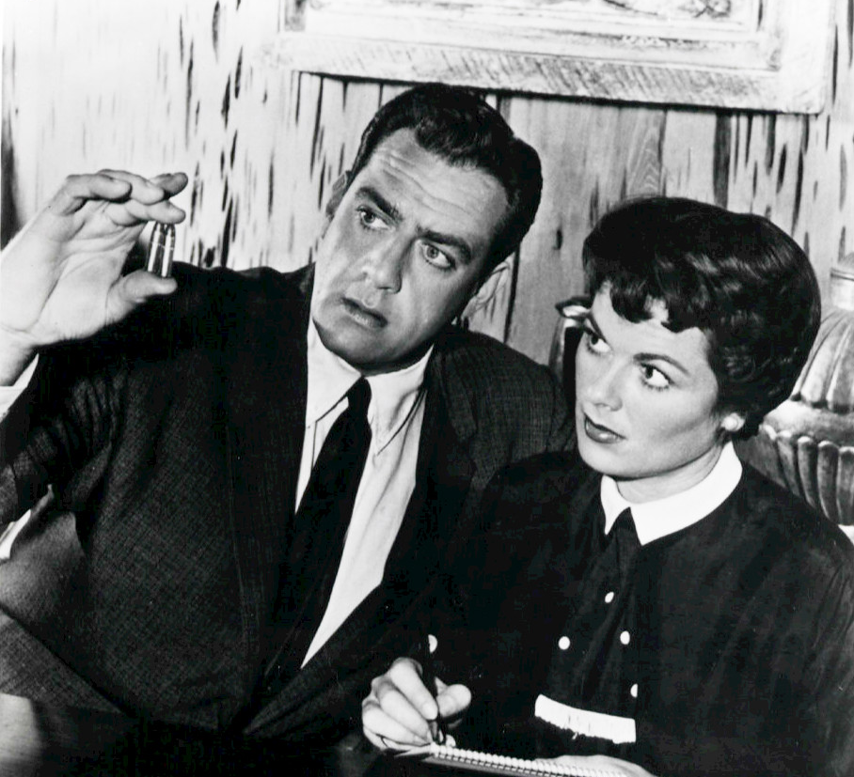
They need an advocate!

Slide 9
This is where we can learn from
User Experience Designers.

Slide 10


UX (User Experience) vs. UI (User Interface)
Which bottle provides the better user experience?

Slide 11
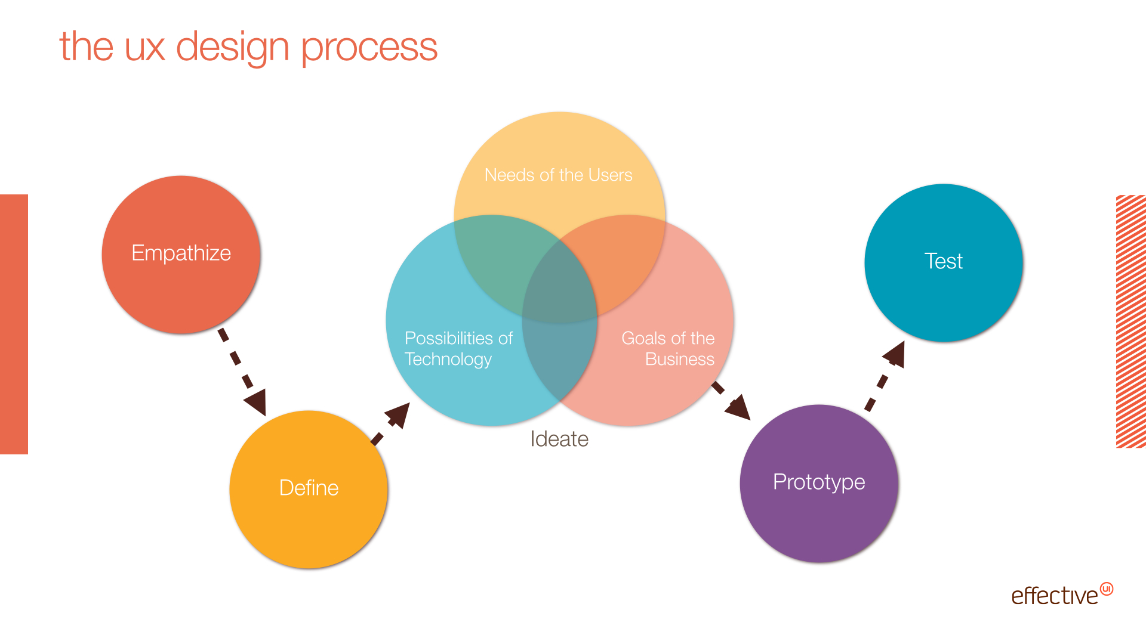

Slide 12
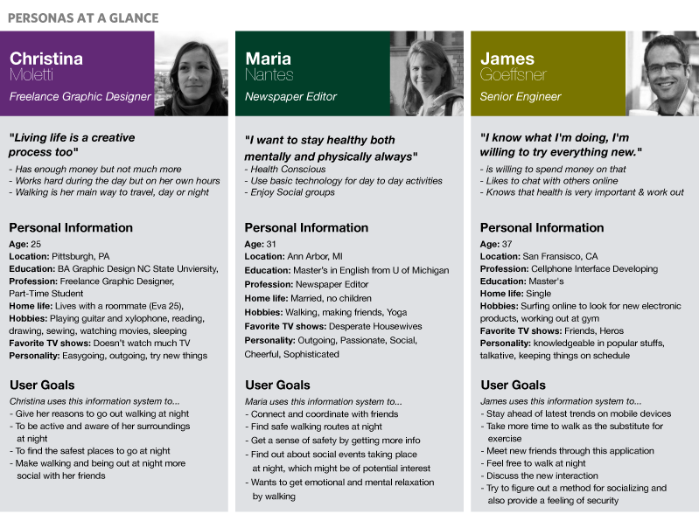
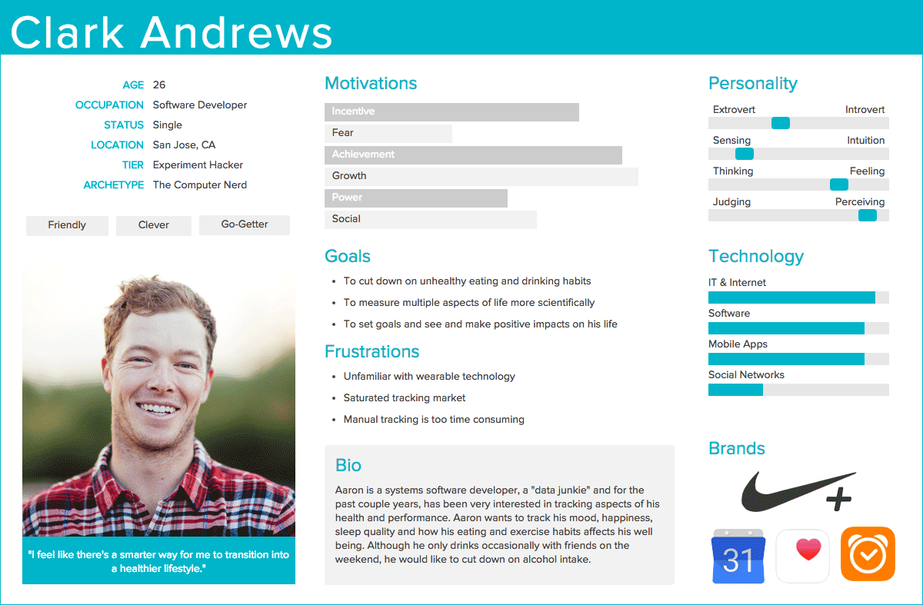
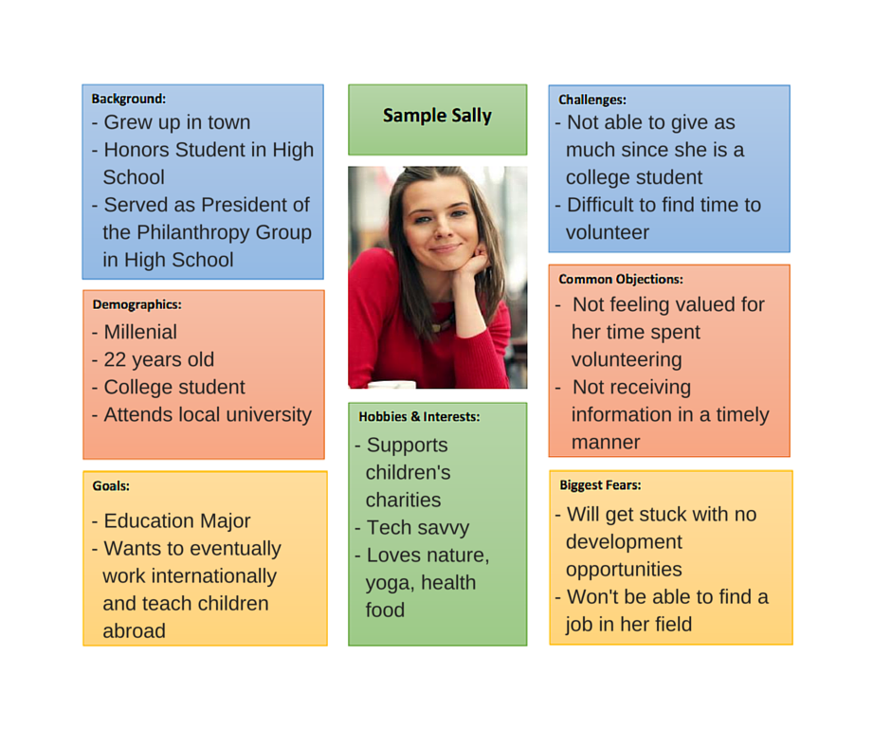
Create User Personas
From LinkedIn Media Group
Free creation software
https://xtensio.com/user-persona/
From Single Grain

Slide 13
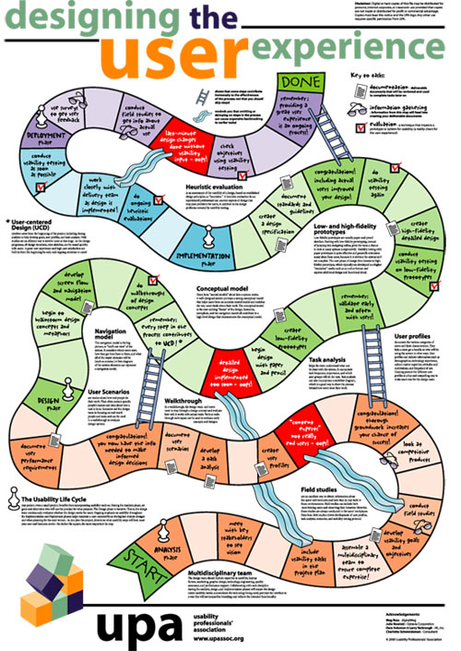
Usability Professionals
Association
https://uxpa.org/
Created by Meg Ross, Julie Nowicki, Dara Solomon, Larry Yarbrough, and Charlotte Schwendeman for the UPA
Download the poster at
http://www.mprove.de/script/00/upa/_media/upaposter_11x17.pdf

Slide 14


Slide 15
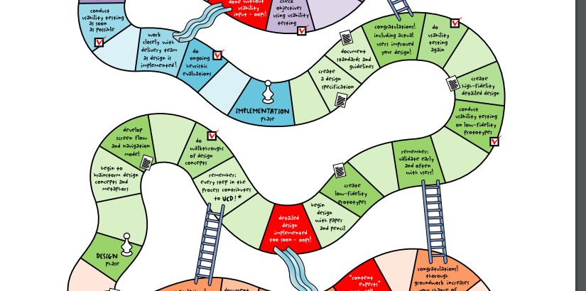

Slide 16
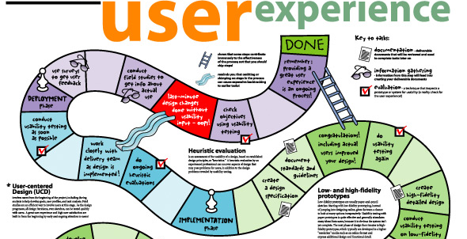

Slide 17
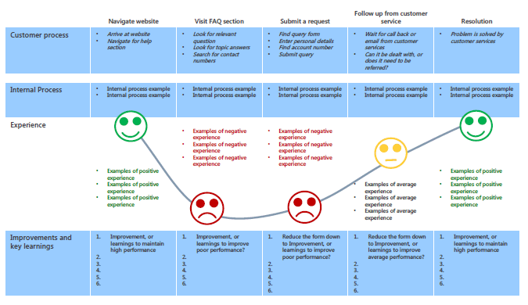
Journey Map – Look for Pain Points
http://cdn.b2binternational.com/

Slide 18

Brent’s Day
Pain Points: Commute traffic in AM & PM, meal prep, desire to relax after work but need to prepare meals, healthy meals take more time to create
Opportunity: Fathers need a way to simplify and shorten meal preparation because they would rather spend time with their kids than cooking

Slide 19
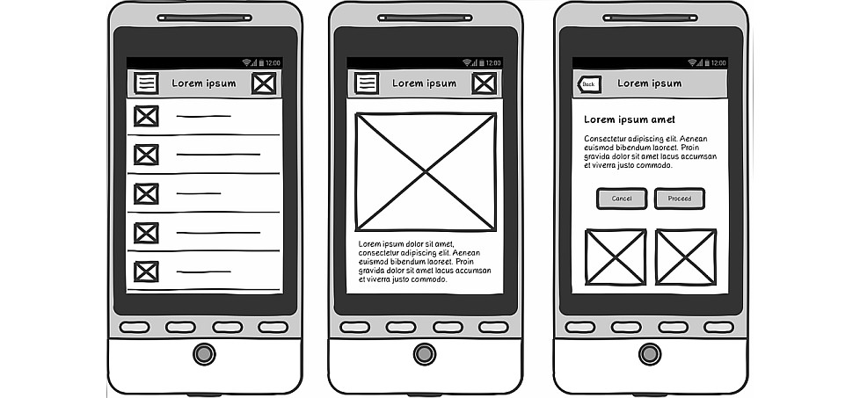
Prototype
http://www.uxforthemasses.com/

Slide 20
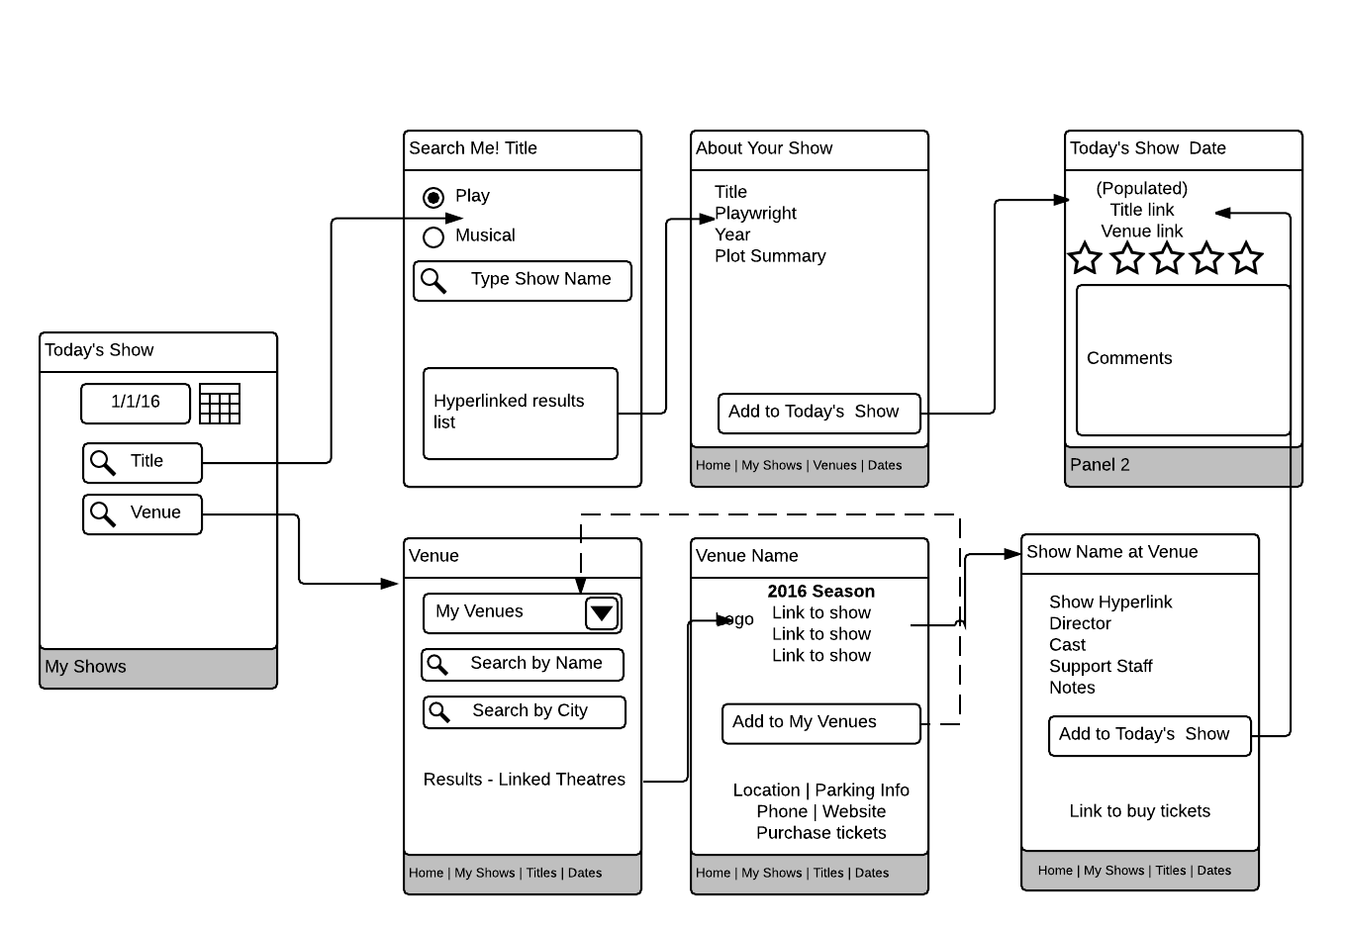
Prototype - Wireframe

Slide 21
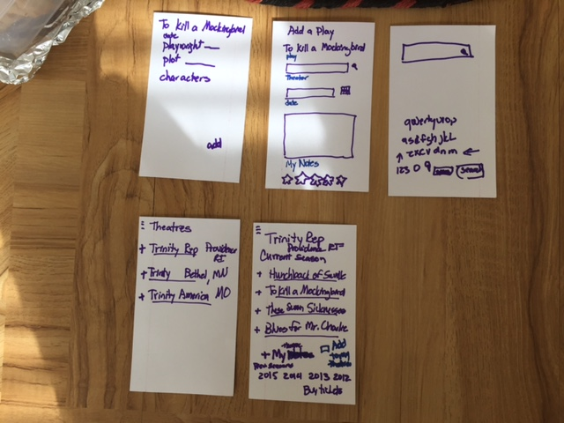
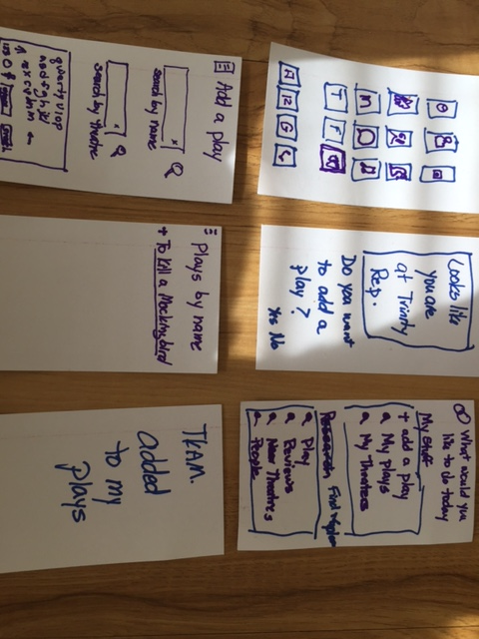
Sketched Mockups/Index Cards

Slide 22

User Testing
Must be actual users
Use Think-alouds
Watch movements
  Eyes
  Mouse
Look for confusion

Slide 23
What can we learn from UX?
Leverage Personas
Create Journey Maps
Prototype simply
Involve users in testing
Remember the user!

Slide 24

Thanks for coming.
Jean Marrapodi, PhD, CPLP | jmarrapodi@illumina-interactive.com | 401-440-6165
Remember to fill in your evaluation.

